Slide 1
Auto Editing App

Slide 2
HELLO!
I am Tan Zhong Ming
You can find me at sf_tanzhongming@qiup.edu.my

Slide 3
It’s supposed to be automatic, but actually you have to push this button.
–John Brunner

Slide 4
1.
Problem
Let’s start with the first set of slides

Slide 5

Problem
Remove stuttered speech manually
Time consuming
High learning curve
Expansive hire editor
Improve the accuracy of speech recognition
Denoising
Audio Pre-process
Deep Speech

Slide 6
Scope
Perform pre-processing techniques to audio data set for better sound quality
Build and train an Artificial Neural Network (ANN) for the stuttered speech classification model.
Build and train an End-to-end deep learning model - Deep Speech
Develop an application and algorithm for Android to automatically remove the stuttered speech.
Implement audio pre-processing technique to improve the accuracy of speech recognition.
Develop an improved version of auto subtitle generator.

Slide 7
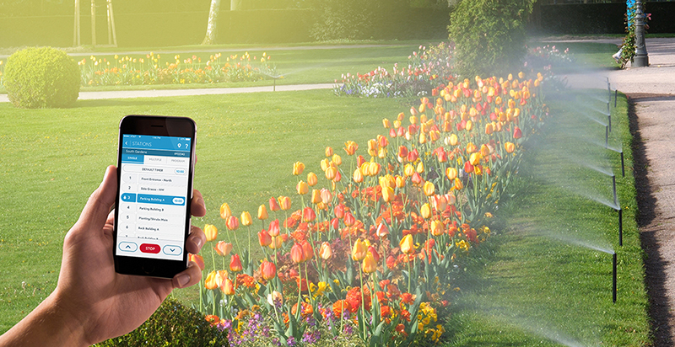
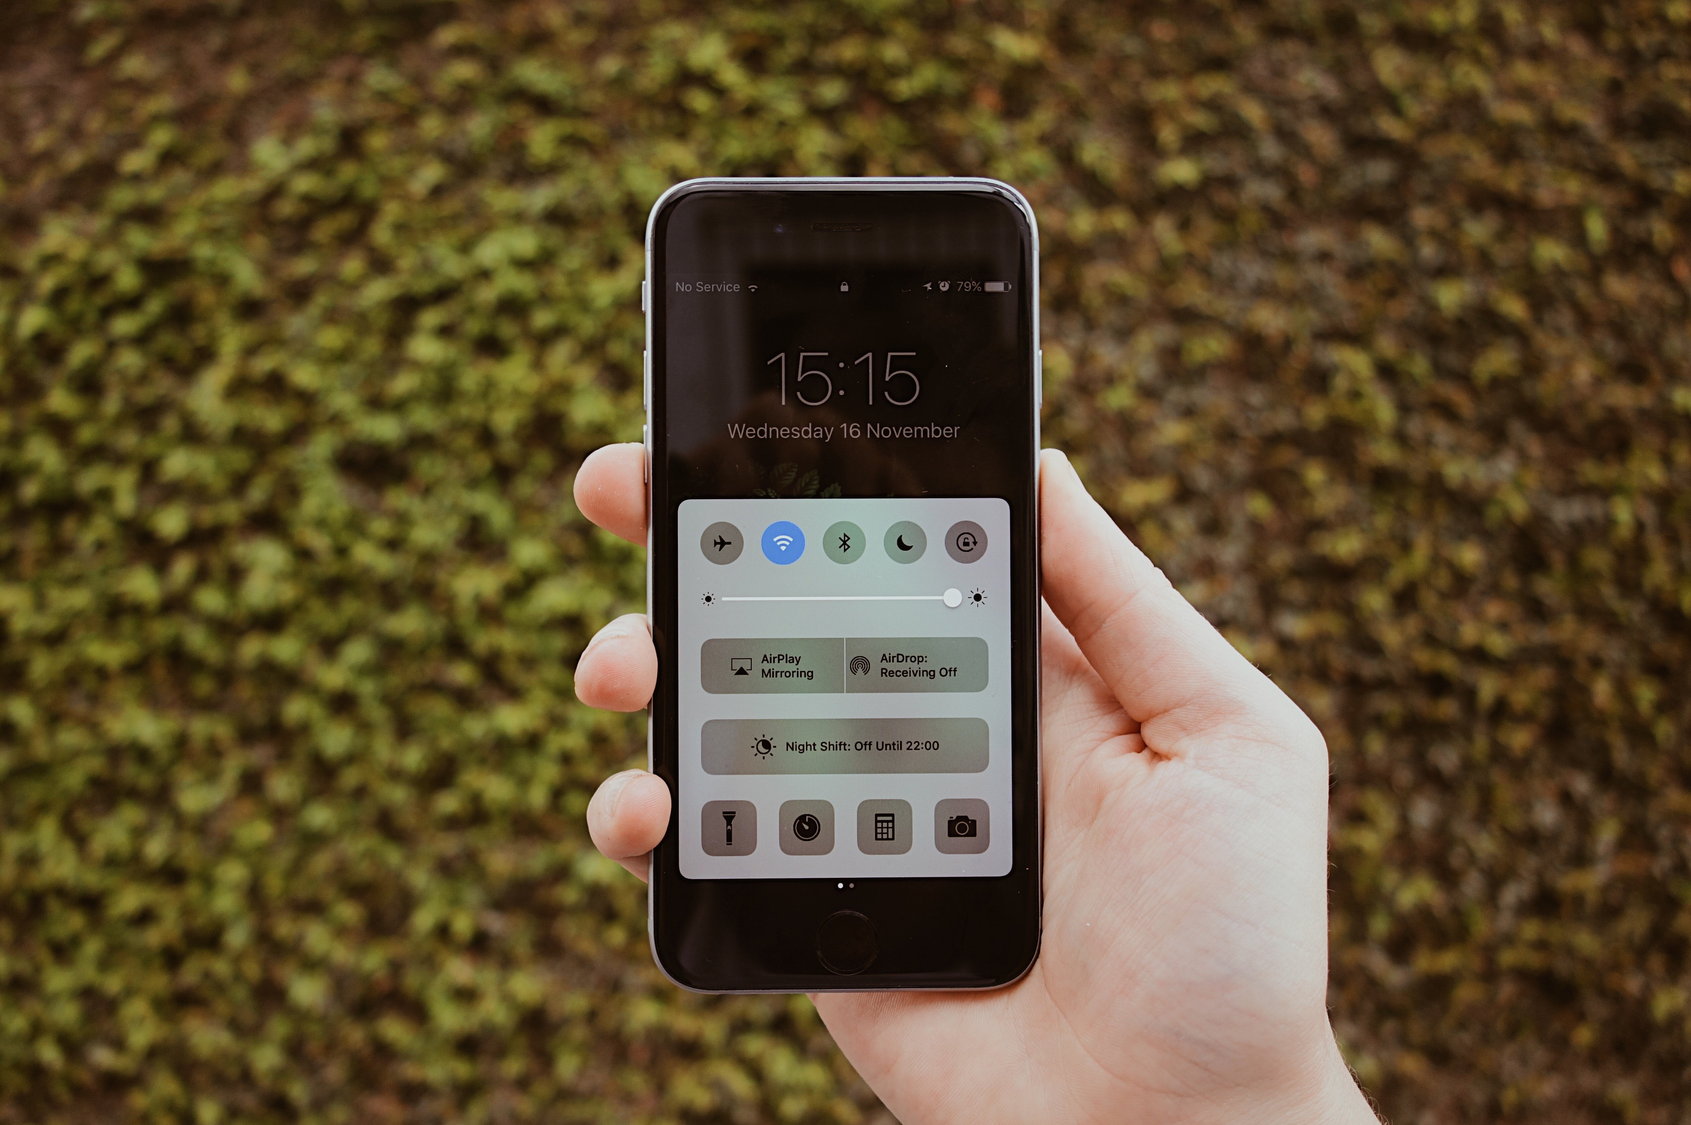
Benefits and Significance
AN AUTO EDIT APP
 | Current Video Editing Process | Proposed Video Editing App
Process | Detect and remove the stuttered speech manually and import one by one from the library | Detect and remove the stuttered speech automatically and in batch by using machine learning
Transcribe | Denoise the speech manually includes normalize, hard-limit, equalizer, noise remove and more. | Denoise and pre-process the speech automatically by using machine learning in batch
Process time | High | Low
Human involvement | High | Low

Slide 8
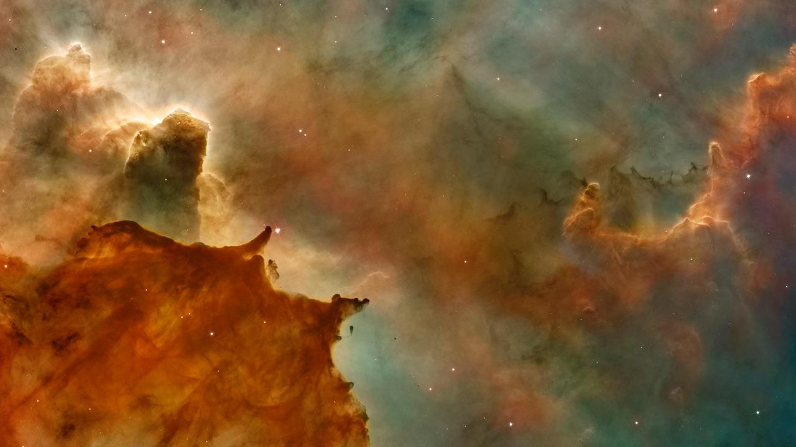
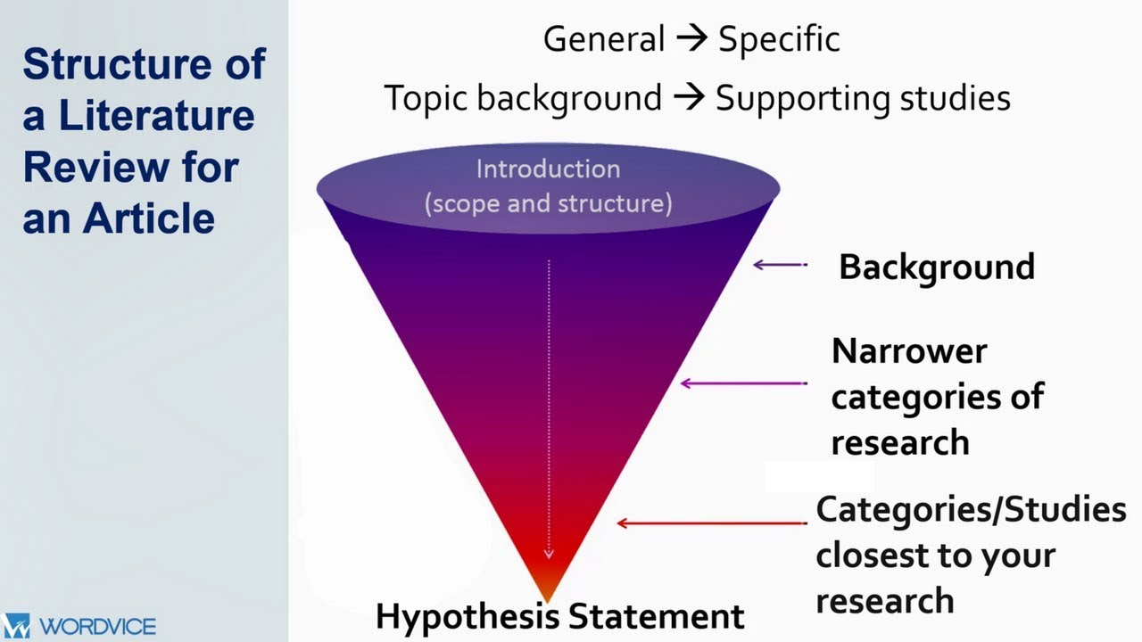
Literature Review

Slide 9
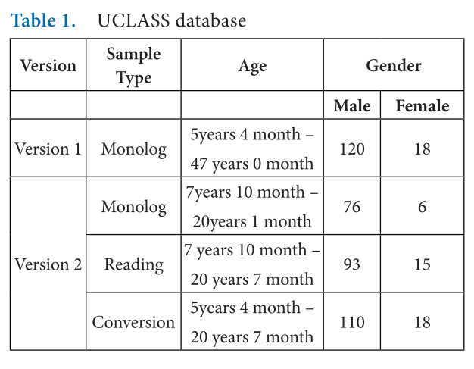
A comparative study
UCLASS
Indian Regional Language
Polish Language
German Language
Swapnil D. Waghmare1*, Ratnadeep R. Deshmukh1, Pukhraj P. Shrishrimal1, Vishal B. Waghmare2 Ganesh B. Janvale3
and Babasaheb Sonawane4 1

Slide 10
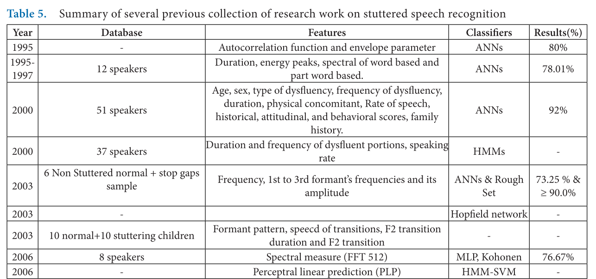
History

Slide 11
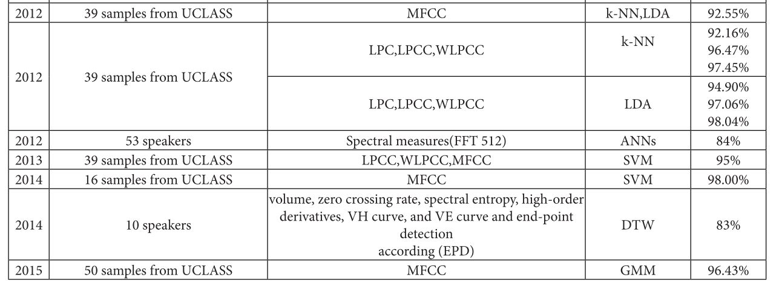
History

Slide 12
Detection and Analysis of Stuttered Speech
MFCC
SVM
96.67%
10-12 coefficient
No Pre-emphasis
Vikhyath Narayan K N, S P Meharunnisa

Slide 13
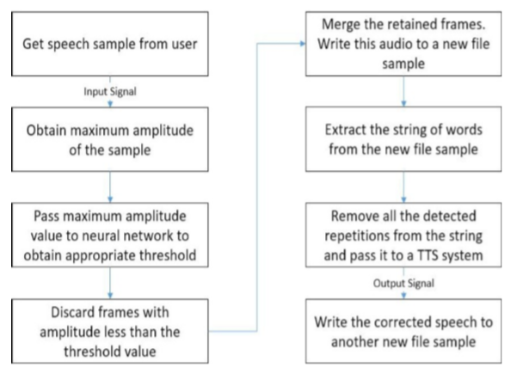
Speech Recognition and Correction of a Stuttered Speech
Identify and Correct the speech
TTS technique
Two algorithm
Remove prolongation
Remove repetition
6 seconds
5 – 8 seconds
86%
Ankit Dash, Nikhil Subramani, Tejas Manjunath, Vishruti Yaragarala and Shikha Tripathi

Slide 14
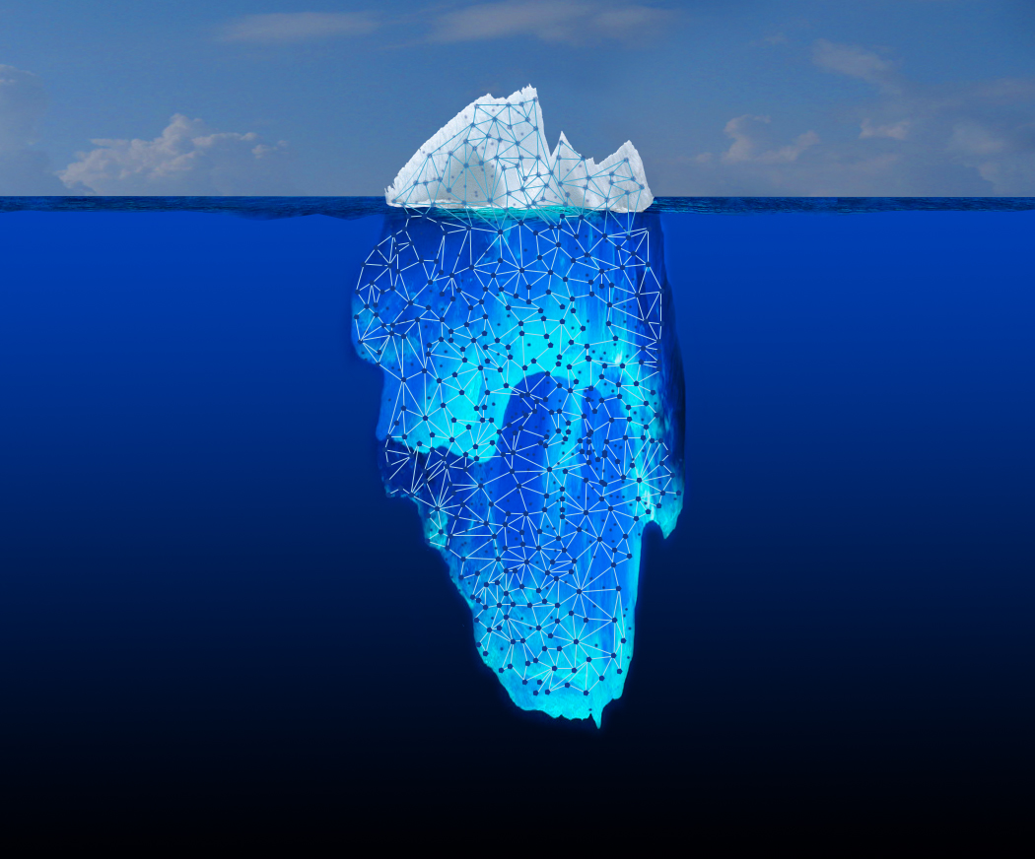
Deep Speech 2
End-to-end deep learning system

Slide 15
Goal
Multiple language in 1 model
Replace existing ASR
Current ASR overcomplicated
Solve multiple issues in current ASR

Slide 16
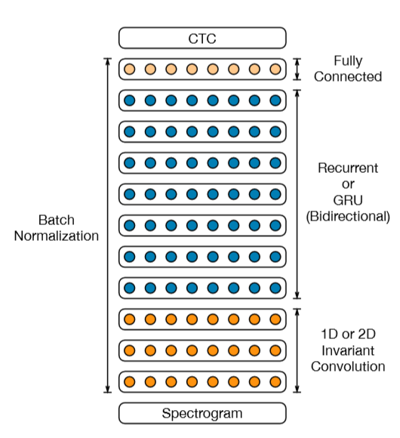
Architecture
11 layers
3 convolution
7 recurrent
1 Fully connected

Slide 17
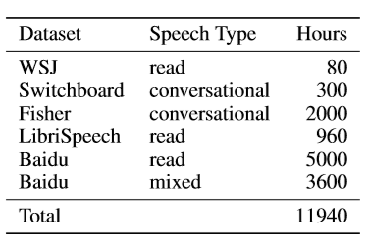
Data
English
Linguistic Data Counsortium
95 minutes / epoch (English)
25 minutes / epoch (Mandarin)
40% Synthetic Noise

Slide 18
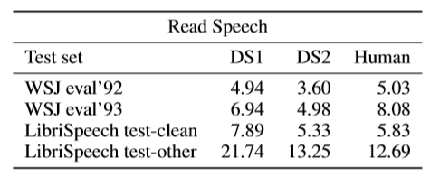
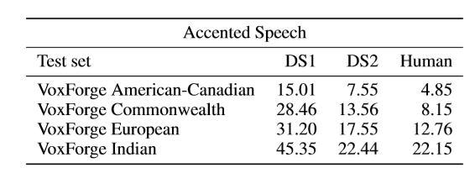
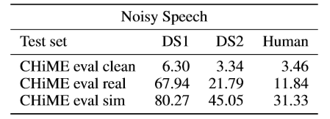
Result
Close to human
Outperform than human
Worse than human

Slide 19

Methodology
Scrum

Slide 20
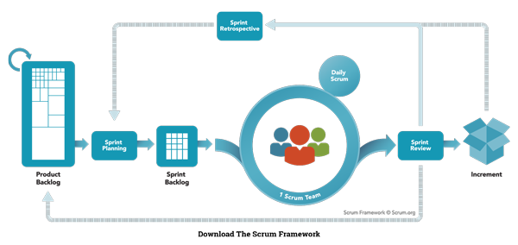
Scrum
Fast
User Story
Product backlog

Slide 21
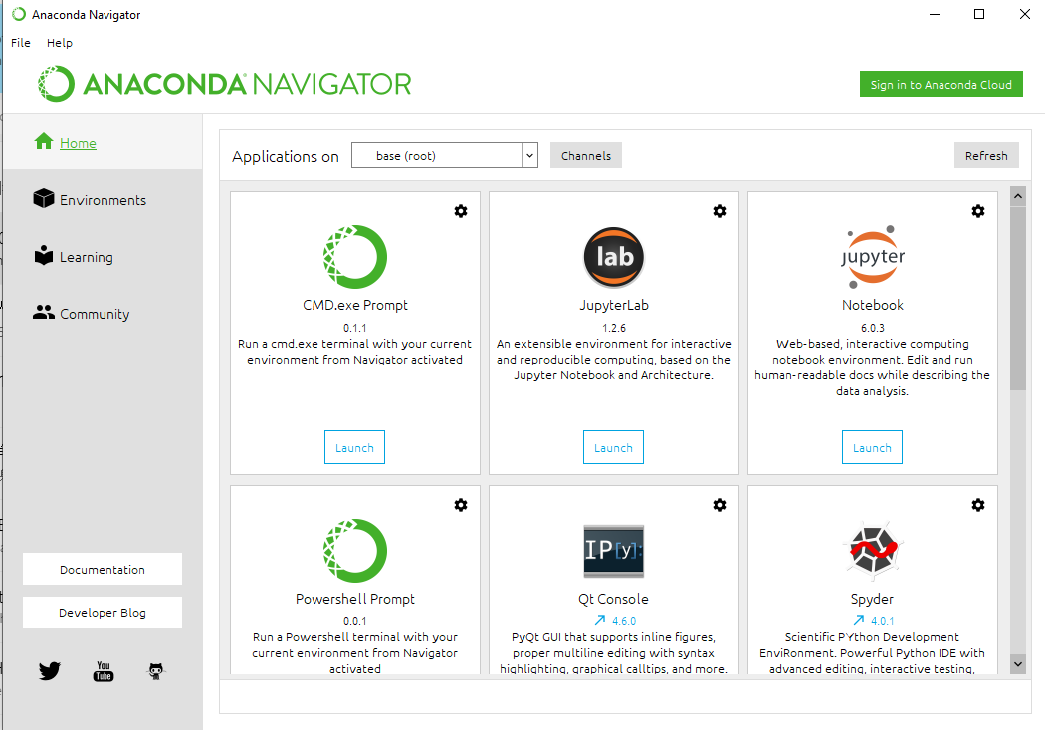
Software
Anaconda3
Python 3.5
Android 6.0 (API23)

Slide 22
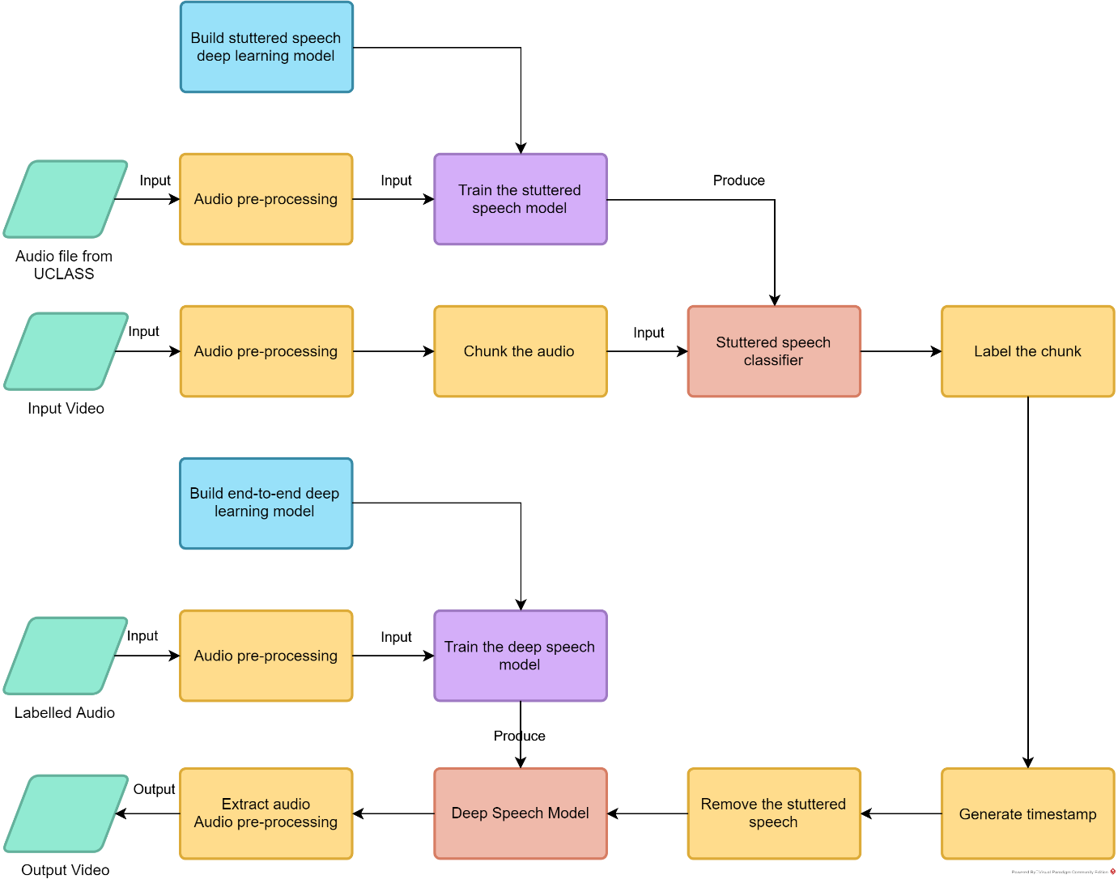

Slide 23
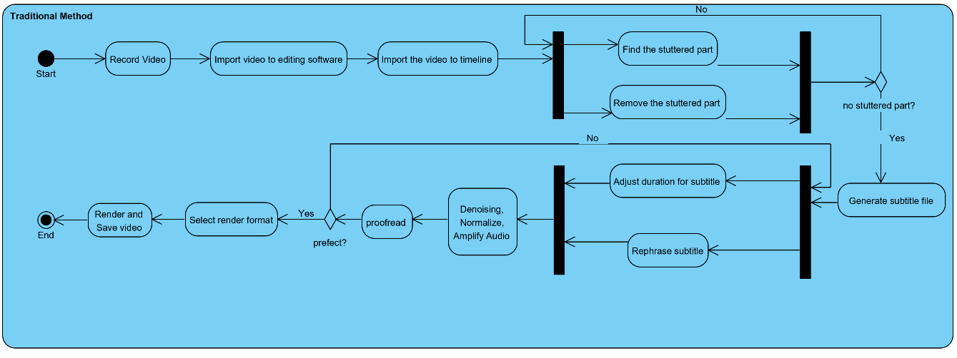

Slide 24
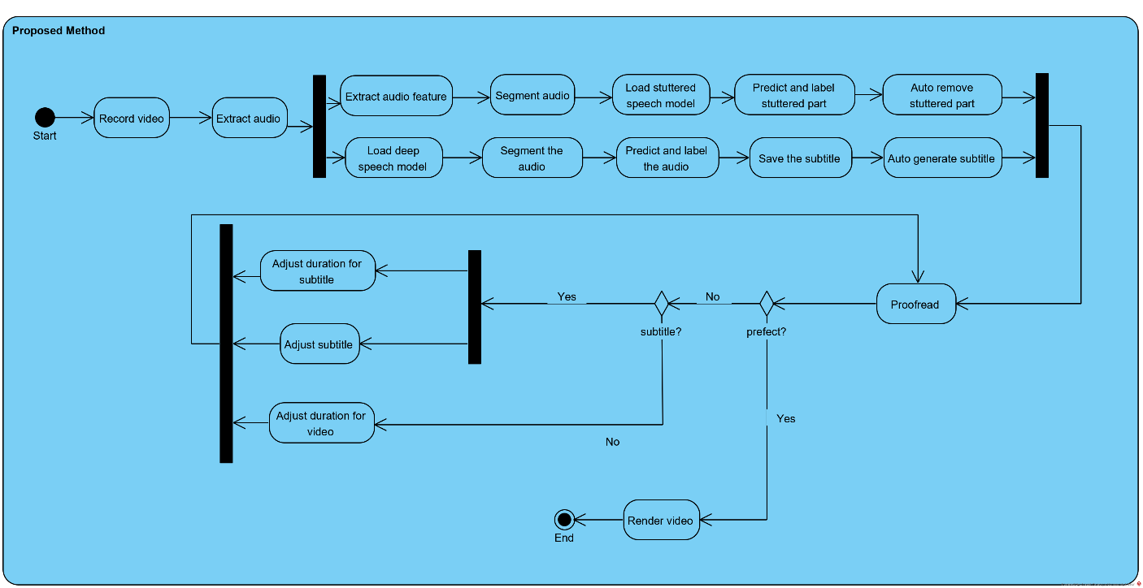

Slide 25
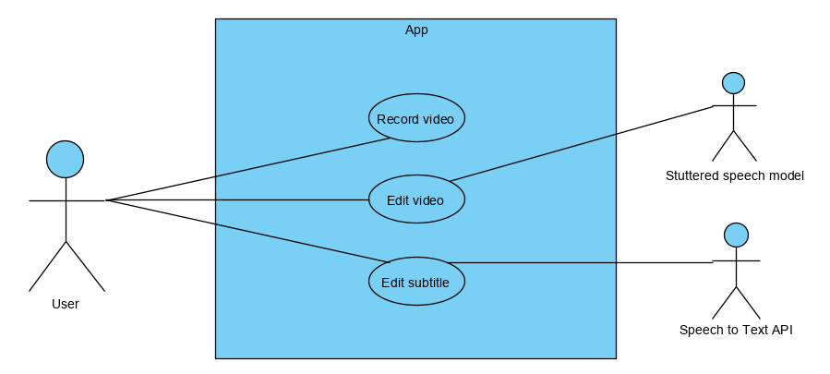

Slide 26
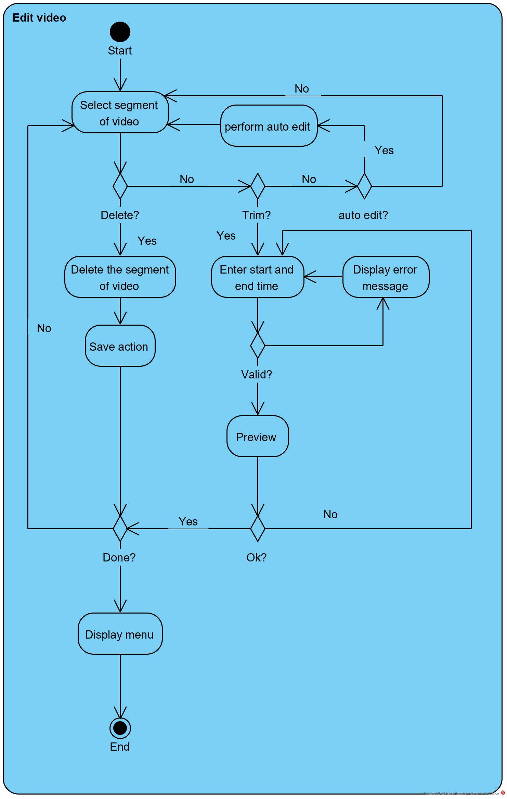

Slide 27

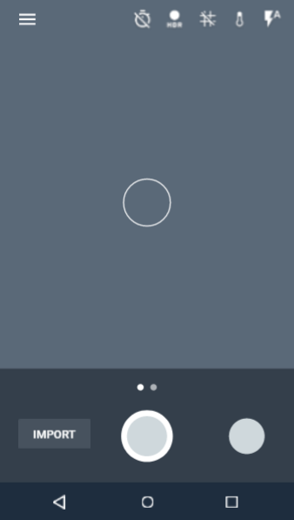
New Design
Place your screenshot here
Home
Edit Video
Edit Subtitle

Slide 28
Home
Place your screenshot here
Record
Import

Slide 29
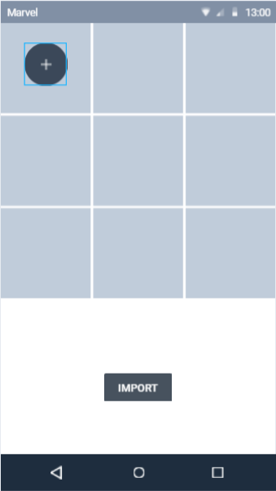
Import
Place your screenshot here
View Gallery
Import

Slide 30
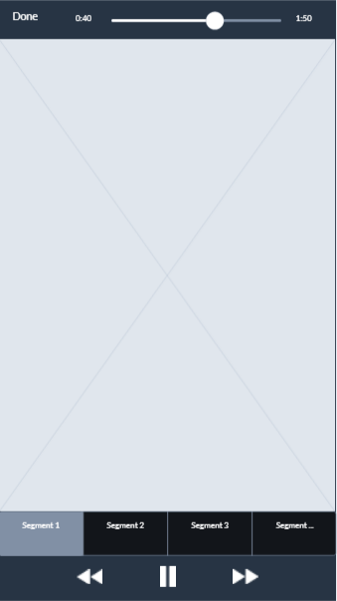
Edit Video
Place your screenshot here
Play / Pause
Segment
Delete

Slide 31
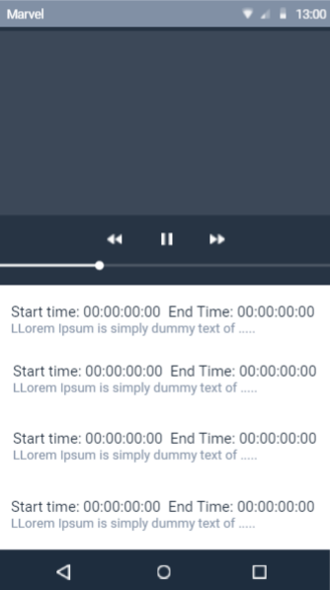
Edit Subtitle
Place your screenshot here
Start / End Time
Subtitle
Preview

Slide 32

THANKS!
Any questions?
You can find me at
sf_tanzhongming@quip.edu.my

